Slide 1
Improving Effectiveness of Direct Marketing through Predictive Modelling
Under the Esteemed guidance of Anjana Agarwal
Submitted by:
Deep Ranjan Guha
Ankit Chatterjee
Piyali Dey
Ronjini Konwar
Sudipto Das
Harshal Singh Chauhan

Slide 2
INTRODUCTION
Industry Review
Direct Marketing and its relevance in the Banking Industry
Telemarketing as a type of Direct Marketing
Areas our project aims to focus
Customer Segmentation
Customer Retention

Slide 3
About the dataset
The data was made available by Moro, Laureano and Cortez (2014) through the popular University of California at Irvine (UCI) machine learning repository.
The dataset also contains record of the customer’s background, socio-economic attributes and the campaign details (Moro, Laureano and Rita, 2014).
There are 41188 records and there are 20 features and 1 class (y) which contains the information of -if the client has subscribed to the term deposit or not.
The output variable named "y" is string which has values either "yes" or "no". Thus we replaced it with binary values: 1 for ‘yes’ and 0 for ‘no’.
Attribute Information
other attributes: 12 - campaign: number of contacts performed during this campaign and for this client (numeric) 13 - pdays: number of days that passed by after the client was last contacted from a previous campaign (numeric) 14 - previous: number of contacts performed before this campaign and for this client (numeric) 15 - poutcome: outcome of the previous marketing campaign (categorical) social and economic context attributes: 16 - emp.var.rate: employment variation rate - quarterly indicator (numeric) 17 - cons.price.idx: consumer price index - monthly indicator (numeric) 18 - cons.conf.idx: consumer confidence index - monthly indicator (numeric) 19 - euribor3m: euribor3 month rate - daily indicator (numeric) 20 - nr.employed: number of employees - quarterly indicator (numeric) Output variable (desired target): 21 - y - has the client subscribed a term deposit? (binary: 'yes','no')
bank client data:
1 - age: (numeric) 2 - job: type of job (categorical) 3 - marital: marital status (categorical) 4 - education: (categorical) 5 - default: has credit in default? (categorical) 6 - housing: has housing loan? (categorical) 7 - loan: has personal loan? (categorical)
related with the last contact of the current campaign:
8 - contact: contact communication type (categorical 9 - month: last contact month of year (categorical) 10 - day_of_week: last contact day of the week (categorical) 11 - duration: last contact duration, in seconds (numeric).

Slide 4
BUSINESS PROBLEM
aims to establish a cost effective way of marketing. To achieve efficient direct marketing, possessing information about the present and estimating future customer’s preferences always provides an edge over the competitors. The availability of prospective customer data combined with improvements in data analysis has prompted firms to develop more customer-oriented strategies in recent decades to remain competitive
Data Prepossessing
Exploratory Data Analysis
Model Evaluation
SOLUTION APPROACH We shall be using data mining approaches to build a predictive model that labels data into a predefined class. Specifically, classification, which is a form of data analysis technique that results in a model and that model can predict predefined classes for unseen data. These models are referred to as classifiers, predicting categorical class labels (discrete, unordered)

Slide 5
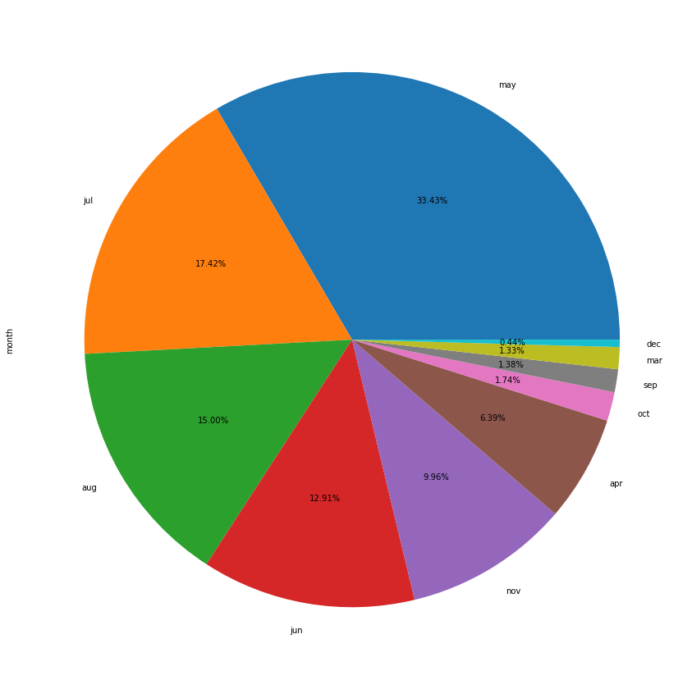
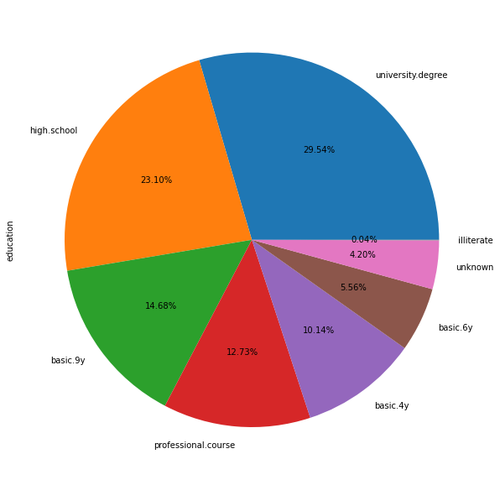
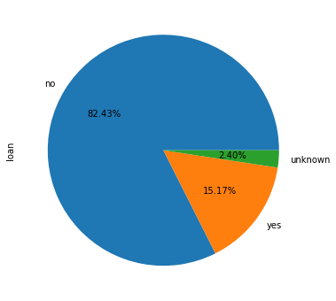
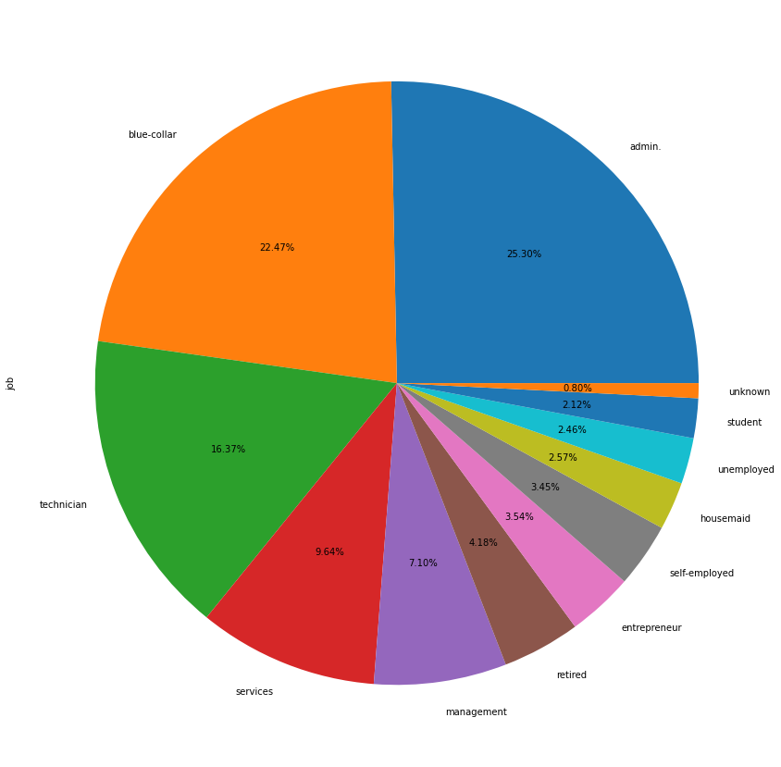
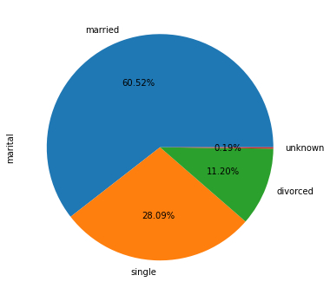
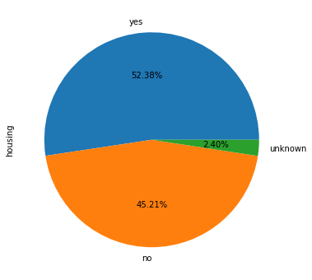
EXPLORATORY DATA ANALYSIS – CUSTOMER SEGMENTATION

Slide 6
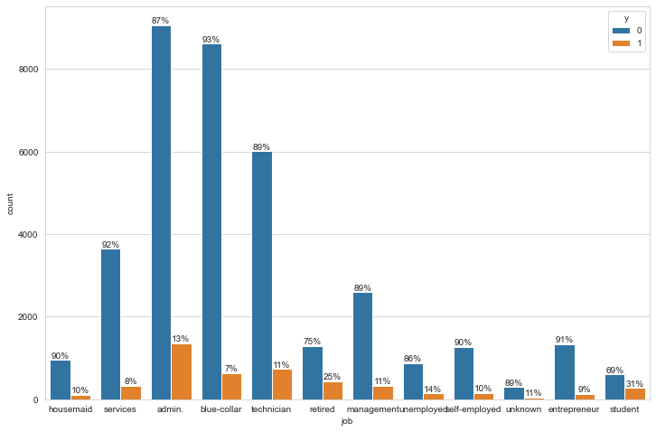
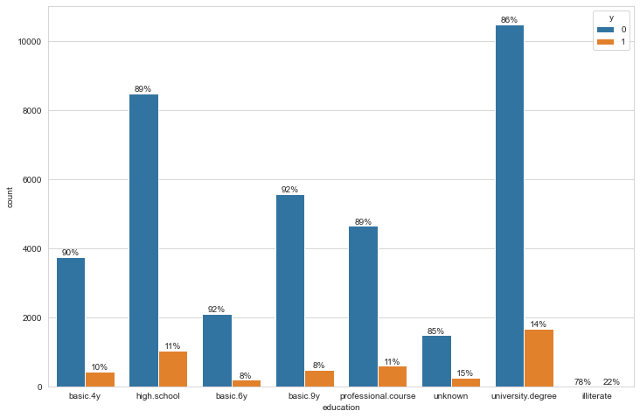
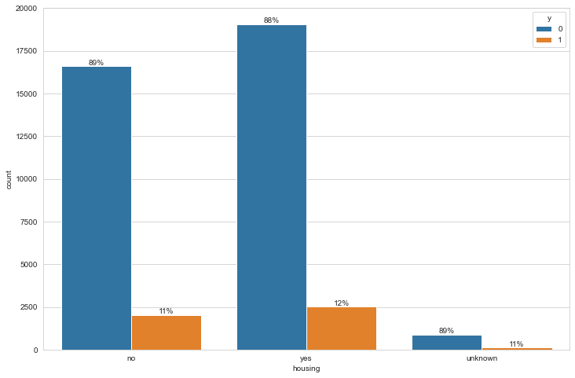
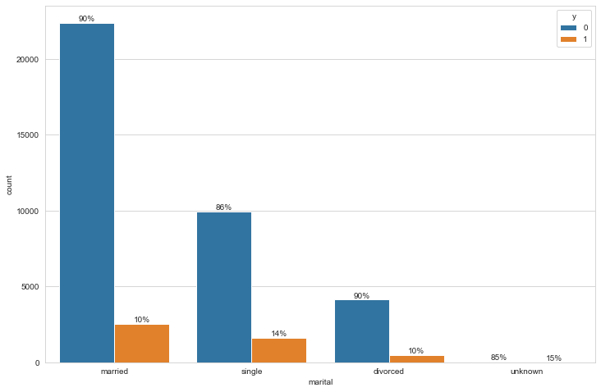
Individual Target Comparison for features

Slide 7
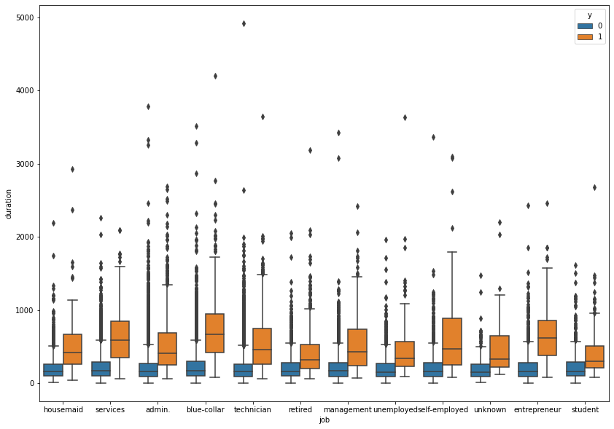
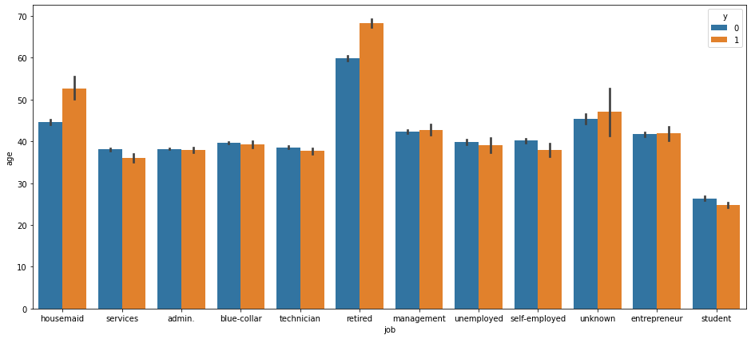
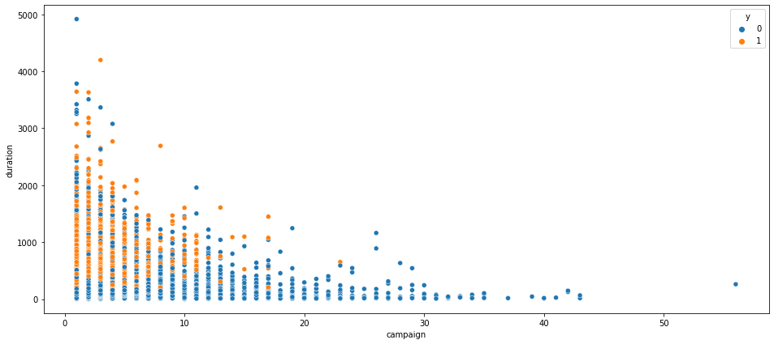
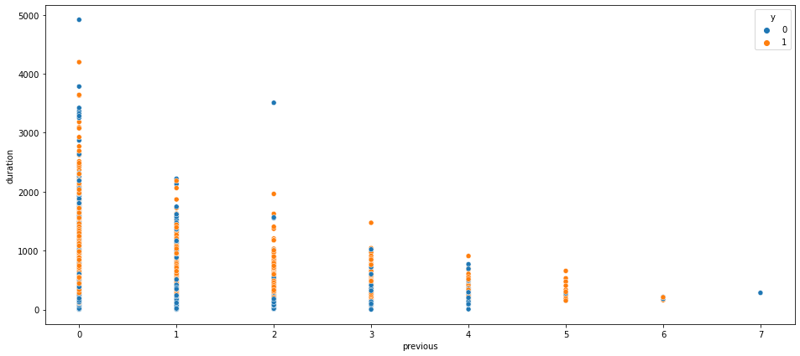
EXPLORATORY DATA ANALYSIS – MULTIVARIATE ANALYSIS

Slide 8
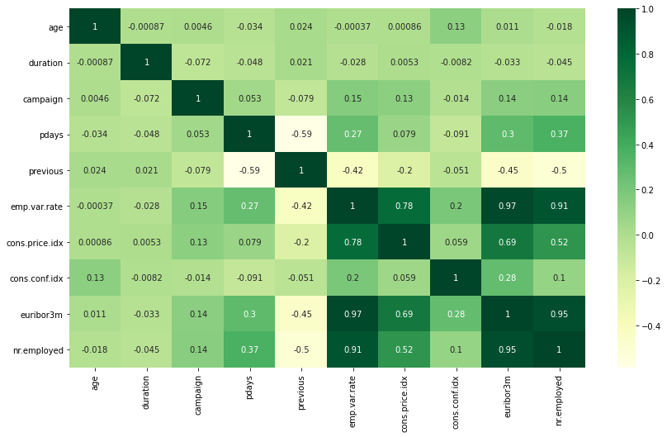
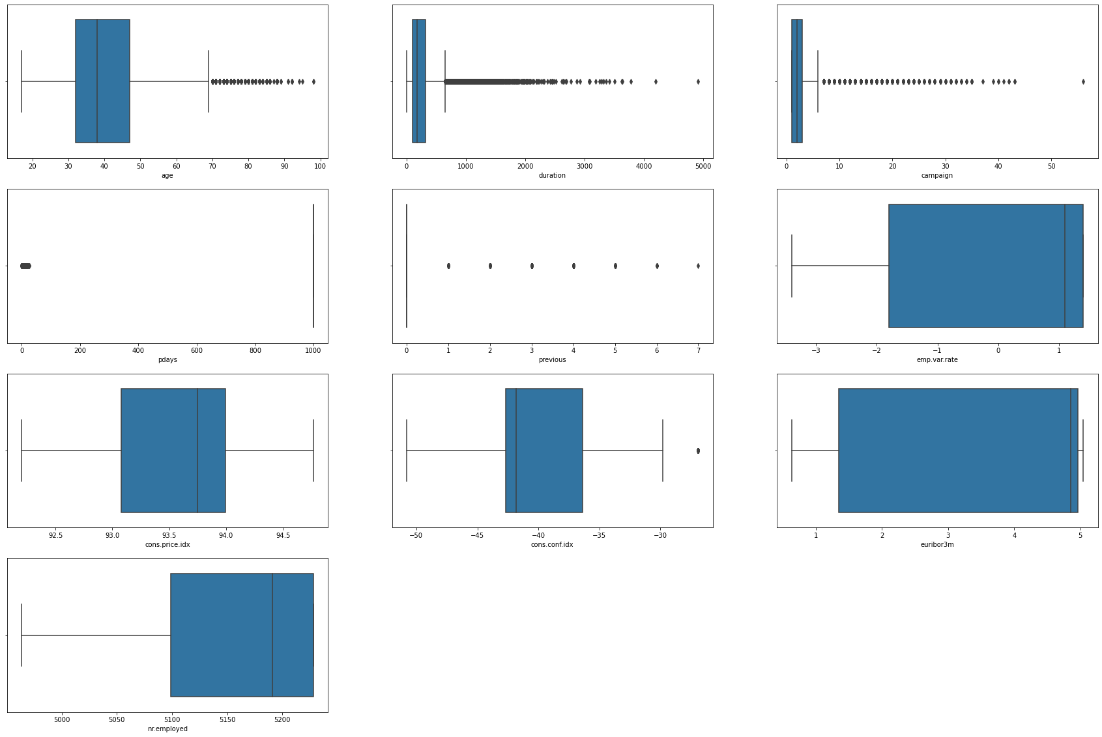
EXPLORATORY DATA ANALYSIS
Numerical Analysis-Outliers Yes/No
Checking for multicollinearity
The emp.var.rate, cons.price.idx, euribor3m and nr.employed features have very high correlation. With euribor3m and emp.var.rate having the highest correlation of 0.97.
Outliers are presence in some attributeslike‘age’,’duration’,’Campaign’

Slide 9
Inferential Statistical Analysis: Chi-Square Test for Independence of Attributes
Sl. No | Categoricalfeatures | Target variable | Degrees of freedom | Critical Value | Test Statistic | P-value | Conclusion
1 | job | y | 11 | 19.6751 | 961.242440 | 4.189763e-199 | Variables are Dependent
2 | marital | y | 3 | 7.8147 | 122.655152 | 2.068015e-26 | Variables are Dependent
3 | education | y | 7 | 14.0671 | 193.105905 | 3.305189e-38 | Variables are Dependent
4 | default | y | 2 | 5.9915 | 406.577515 | 5.161958e-89 | Variables are Dependent
5 | housing | y | 2 | 5.9915 | 5.684496 | 5.829448e-02 | Variables are Independent
6 | loan | y | 2 | 5.9915 | 1.094028 | 5.786753e-01 | Variables are Independent
7 | contact | y | 1 | 3.8415 | 863.269081 | 9.481264e-190 | Variables are Dependent
8 | month | y | 9 | 16.9190 | 3101.149351 | 0.000000e+00 | Variables are Dependent
9 | day_of_week | y | 4 | 9.4877 | 26.144939 | 2.958482e-05 | Variables are Dependent
10 | poutcome | y | 2 | 5.9915 | 4230.523798 | 0.000000e+00 | Variables are Dependent

Slide 10
Non-Parametric Test: Mann-Whitney U
 |  |  |  |  | Observations
Numerical features | Target variable | Test Name | P-Value | Conclusion | Test Type | Test Name | P-value | Conclusion
Age | y | Shapiro | 8.83E-40 | Not Normal | Non-Parametric | Mann-Whitney U Test | 4.18E-131 | Two population are different for variable age
Duration | y | Shapiro | 2.54E-31 | Not Normal | Non-Parametric | Mann-Whitney U Test | 7.28E-153 | Two population are different for variable duration
Campian | y | Shapiro | 0 | Not Normal | Non-Parametric | Mann-Whitney U Test | 3.06E-49 | Two population are different for variable campaign
Pdays | y | Shapiro | 0 | Not Normal | Non-Parametric | Mann-Whitney U Test | 0 | Two population are different for variable pdays
Previous | y | Shapiro | 0 | Not Normal | Non-Parametric | Mann-Whitney U Test | 0 | Two population are different for variable previous
emp.var.rate | y | Shapiro | 0 | Not Normal | Non-Parametric | Mann-Whitney U Test | 6.19E-19 | Two population are different for variable emp.var.rate
cons.price.idx | y | Shapiro | 0 | Not Normal | Non-Parametric | Mann-Whitney U Test | 8.37E-96 | Two population are different for variable cons.price.idx
cons.conf.idx | y | Shapiro | 0 | Not Normal | Non-Parametric | Mann-Whitney U Test | 0 | Two population are different for variable cons.conf.idx
euribor3m | y | Shapiro | 0 | Not Normal | Non-Parametric | Mann-Whitney U Test | 0 | Two population are different for variable euribor3m
nr.employed | y | Shapiro | 0 | Not Normal | Non-Parametric | Mann-Whitney U Test | 0 | Two population are different for variable nr.employed

Slide 11
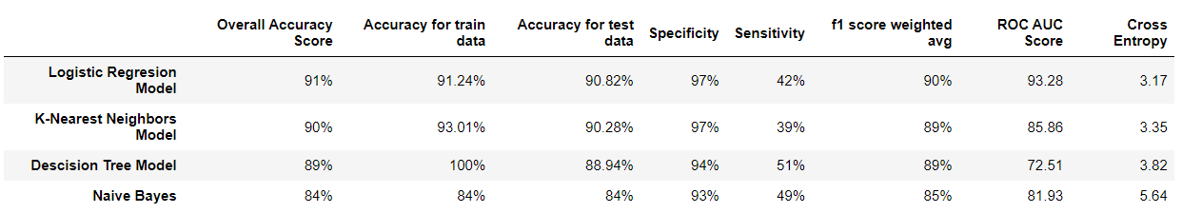
Predictive Modelling and Observations
Classification
Logistic Regression Model
K-Nearest Neighbors Classification Model
Decision Tree Classification Model
Naïve Bayes Model
We have fitted four base models for classification like Logistic Regression Model, KNN Model and a Decision Tree model and Naïve Bayes model

Slide 12
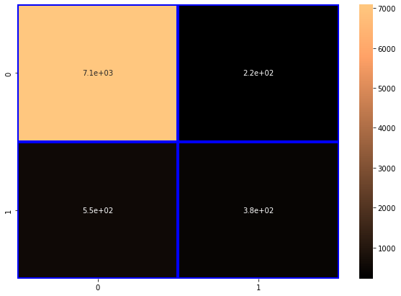
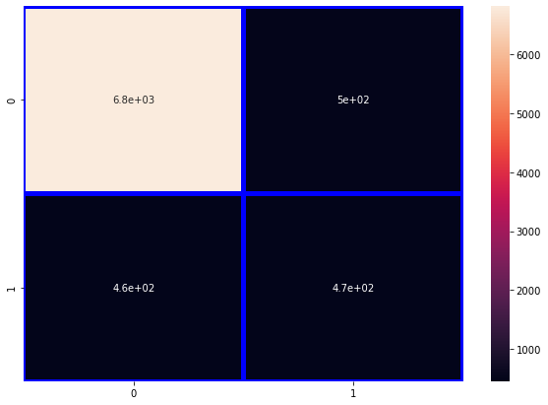
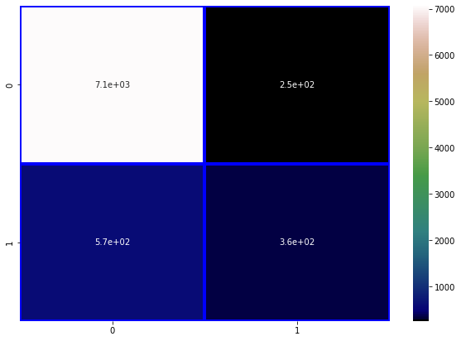
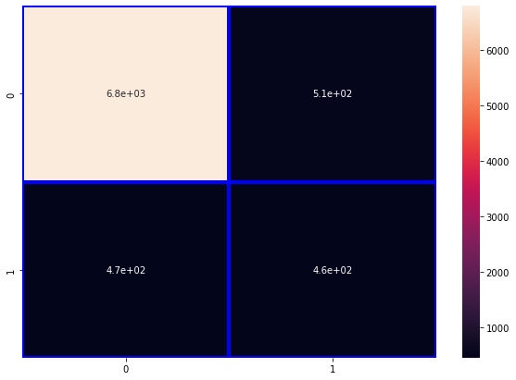
Confusion Matrix comparison
Confusion Matrix for Decision Tree Model :
-----------------------
[[6812 498]
[ 458 470]]
Confusion Matrix for Naïve Bayes Model :
----------------------------
[[6801 509]
[ 472 456]]
Confusion Matrix for Logistic Regression Model :
-------------------------
[[7089 221]
[ 544 384]]
Confusion Matrix for K-Nearest Neighbours' Model :
-------------------------
[[7059 251]
[ 572 356]]

Slide 13
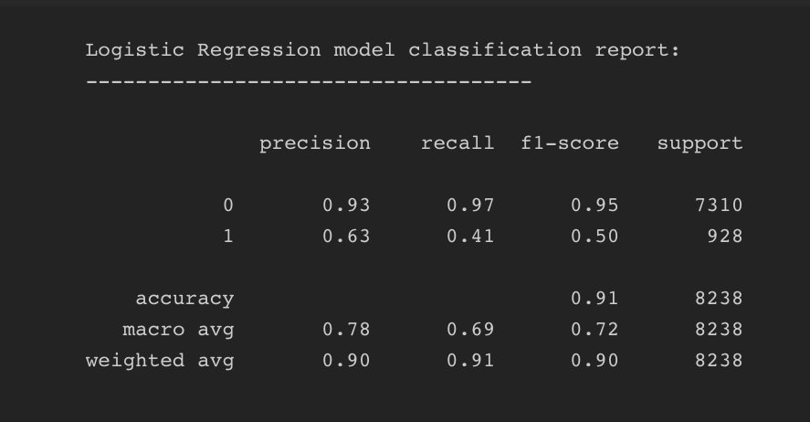
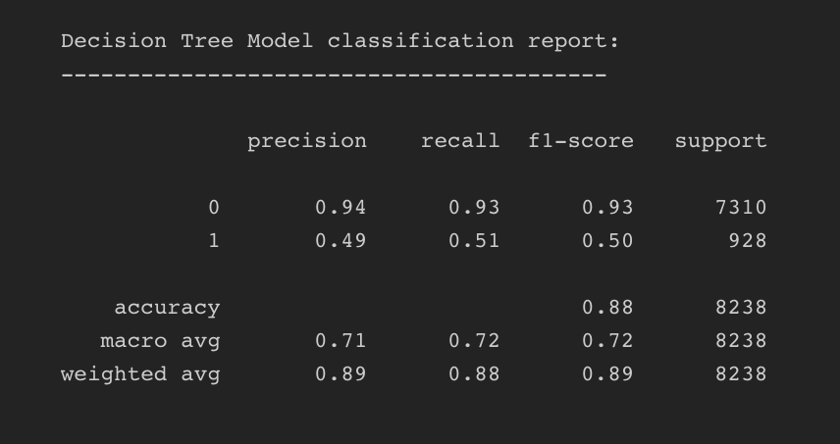
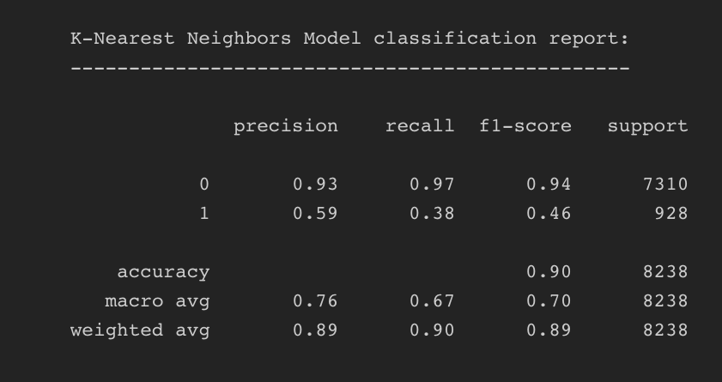
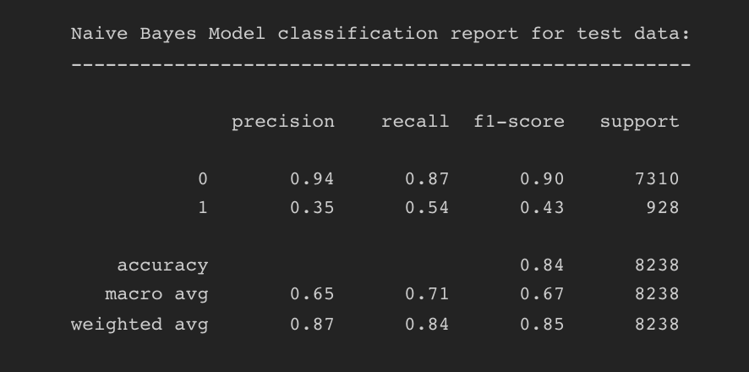
CLASSIFICATION REPORT
Specificity - 93.18%
Sensitivity - 50.64%
Specificity - 96.97%
Sensitivity - 41.37%
Specificity - 96.56%
Sensitivity - 38%
Specificity - 93%
Sensitivity - 49%

Slide 14
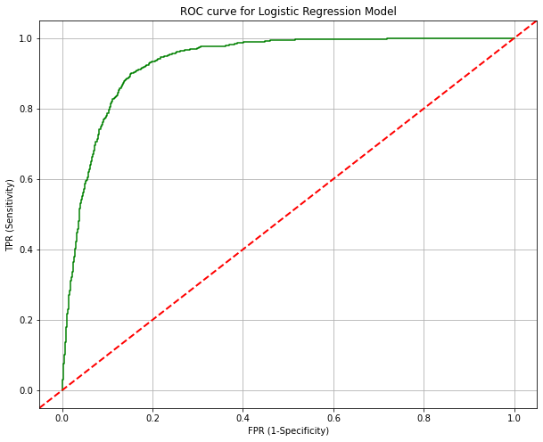
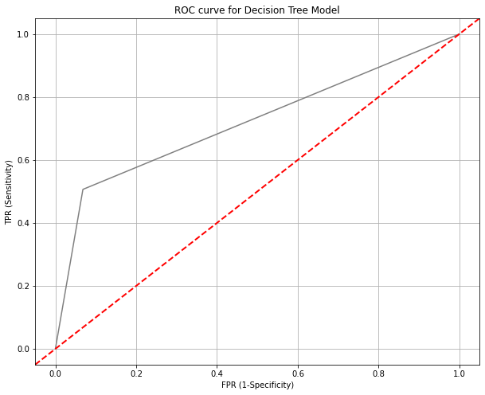


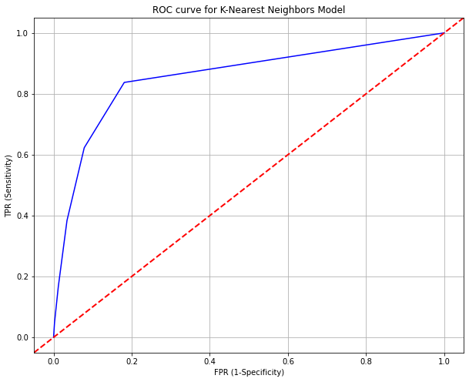
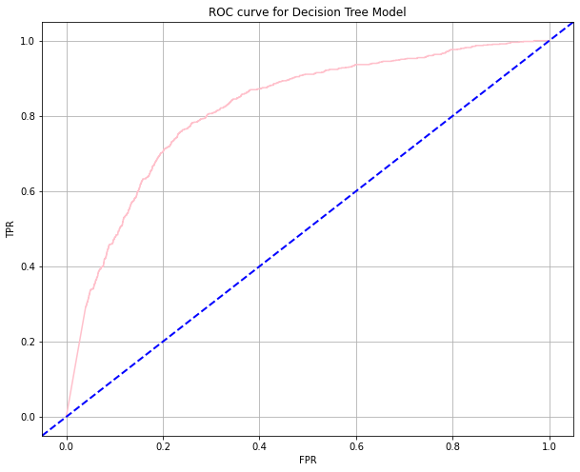


ROC Curve and ROC AUC Score
ROC AUC Score: 93.15
ROC AUC Score: 71.91
ROC AUC Score: 81.93
ROC AUC Score: 85.66
Conclusion
The Logistic Regression model has the highest AUC score.

Slide 15
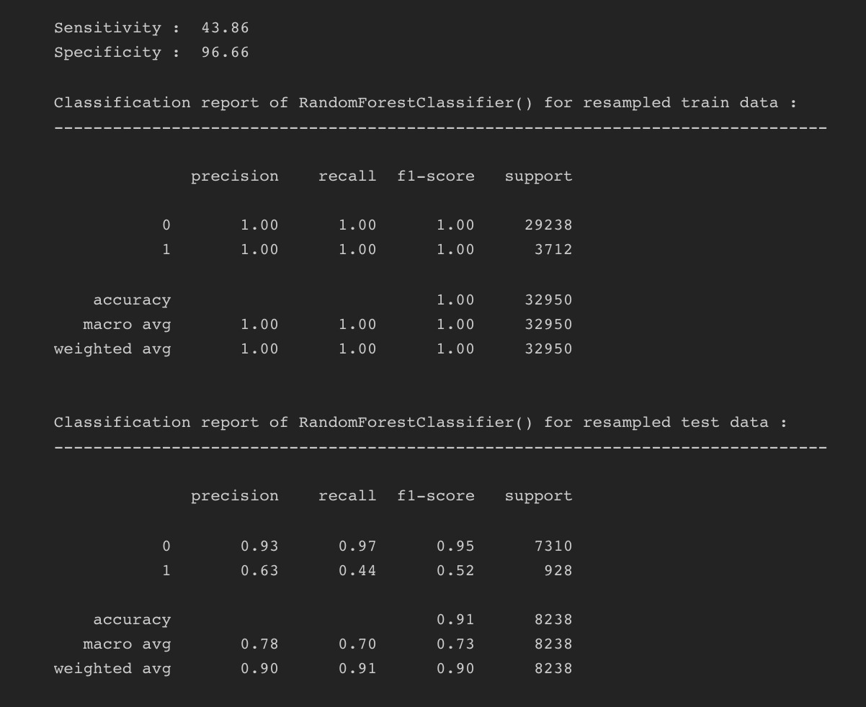
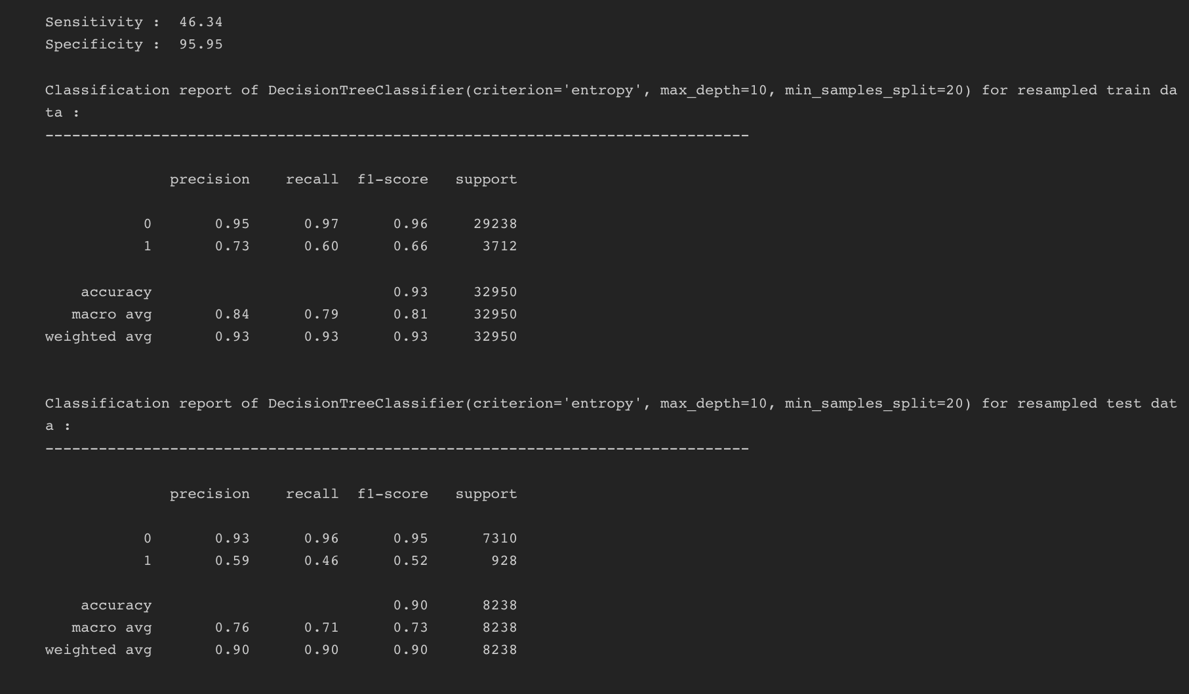
Hyperparameter tunning/Post-pruning
Each base model has been chosen and a set of parameters has been considered for fine tuning. Using these set of parameters we have used Grid Search Cross Validation technique for Hyperparameter tunning the models where the Cross Validation method considered is 10-Fold Cross Validation.

Slide 16
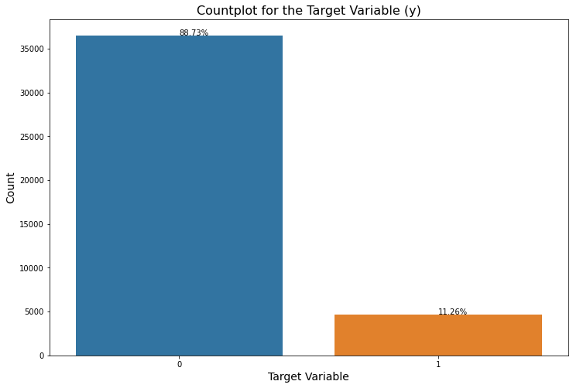
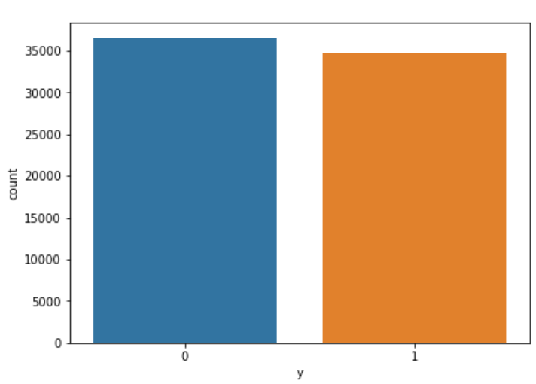
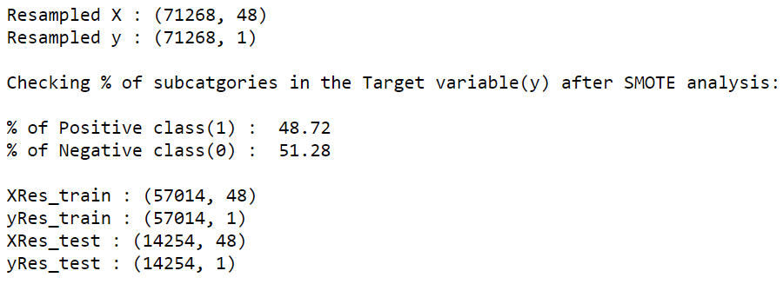
Treating Imbalanced Data
One approach to address imbalanced datasets is to oversample the minority class. The simplest approach involves duplicating examples in the minority class, although these examples don’t add any new information to the model. Instead, new examples can be synthesized from the existing examples. This is a type of data augmentation for the minority class and is referred to as the Synthetic Minority Oversampling Technique(SMOTE)
Smote Analysis

Slide 17
Feature Engineering
We have used Recursive Feature Elimination(RFE) method to obtain a subset of features which contribute significantly to the model from the overall resampled data using a base Random Forest model on the complete resampled data. The features that will be considered for further model building and optimization are :
'education_high.school', 'day_of_week_tue', 'day_of_week_thu', 'day_of_week_mon', 'month_may', 'contact_telephone', 'loan_yes', 'housing_yes', 'default_unknown', 'education_university.degree', 'day_of_week_wed', 'education_basic.9y', 'marital_single', 'marital_married', 'job_technician', 'poutcome_success', 'previous', 'cons.price.idx', 'age', 'cons.conf.idx', 'nr.employed', 'duration', 'job_blue-collar', 'campaign'
Bagging and Boosting algorithms
Using the above features we have deployed a bagging classifier i.e. a Random Forest model with default parameters and three boosting classifiers like AdaBoost model, Gradient Boost model and XGBoost model and have done a critical analysis based on the model sensitivity and specificity,f1-weighted average and ROC AUC score to compare each model.

Slide 18
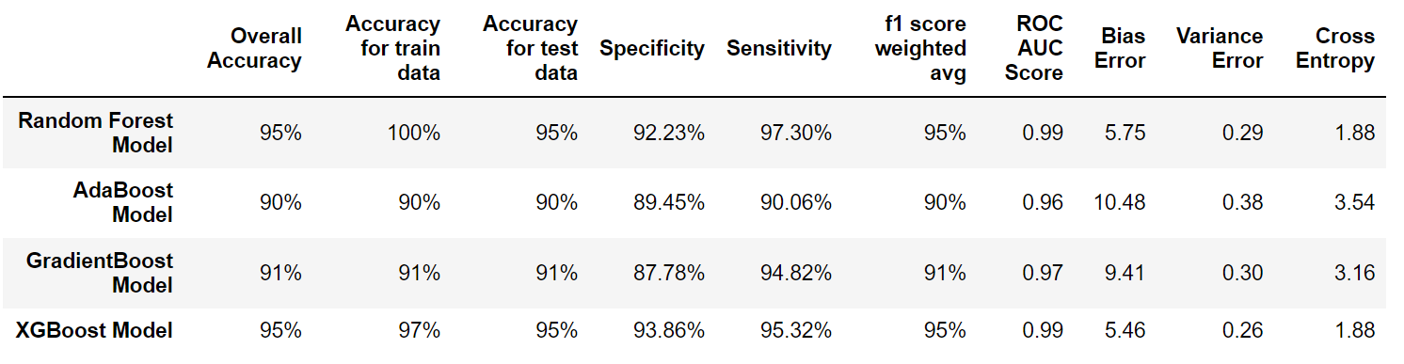
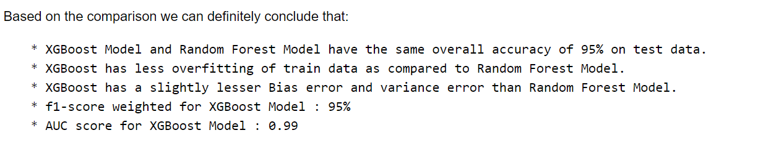
Overall Model Comparison

Slide 19
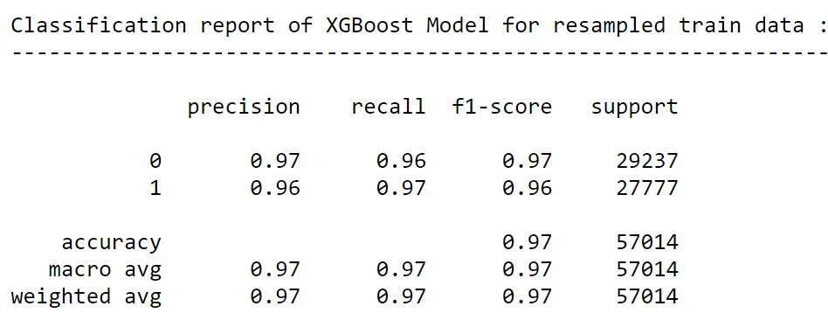
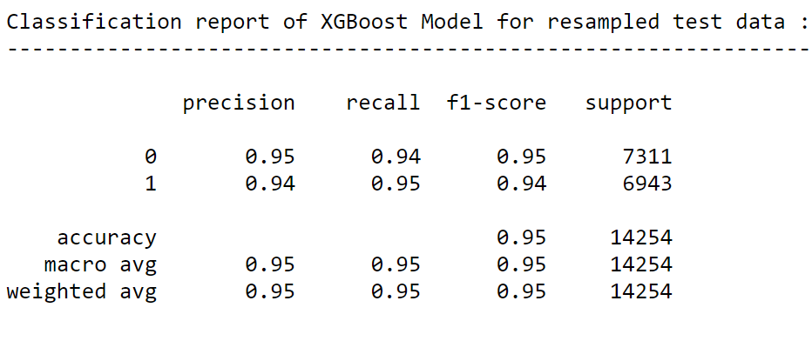
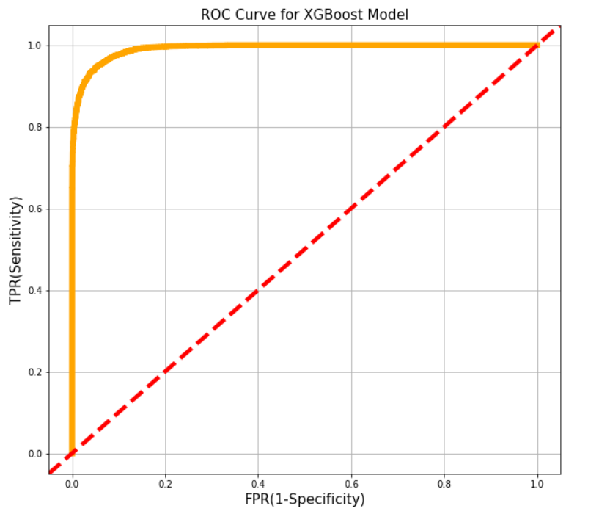
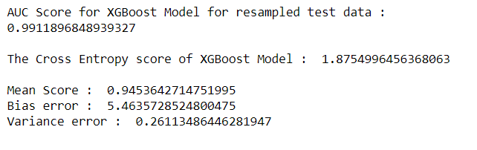

Slide 20
Limitations and Future work
SMOTE analysis is not very practical for high dimensional data and is not a convenient way to treat imbalance which can be better resolved by generating actual data from the domain.
Complex algorithms like neural networks can be deployed.
The XGBoost Model can be further fine tunned to enhance the performance.
The model can be further improved with more detailed analysis and deployed on a cloud based environment like AWS, Microsoft Azure, Heroku etc.
References
https://paginas.fe.up.pt/~ec/files_0405/slides/02%20CRISP.pdf
https://en.wikipedia.org/wiki/Cross-industry_standard_process_for_data_mining
https://archive.ics.uci.edu/ml/datasets/bank+marketing
https://towardsdatascience.com/developing-a-multi-layer-perceptron-for-a-bank-marketing-dataset-f754deee49fb
https://stackoverflow.com/
https://www.geeksforgeeks.org/python-programming-language/

Slide 21
Thank You!

